Slide 1
Customer Churn prediction for SyriaTel
Timothy Ikiao

Slide 2
Business Problem and Stakeholder Understanding
The Business problem is that customers or users are terminating their custom with the Telco. This churn is making it difficult to determine revenue and is a threat to the stability of the business.
Syriatel therefore wishes to identify customers who are likely to leave or churn before they actually do leave and the drivers of this churn.
The key stakeholder here is the telecommunications company, specifically the Customer Retention Manager at the Telco.

Slide 3
Overview of data provided and analysed
The data provided consists of 21 columns with 3333 entries. Columns include data on churn, calls and minutes during the day, evening, night and internationally.
Important to note is that the data is imbalanced meaning that 85% of the data provided is of customers who did not churn while only 14.5% is of customers who churned.
This presents a challenge in modelling and evaluation of models and this will be one of the limitations.

Slide 4
Model Development
The variable to be predicted was identified as ‘churn’ (y) while the other columns formed the feature columns (X) except phone no. and total charges columns.
80% of the data was used to train the model while 20% of the data was used for testing. This is an accepted industry standard.
We used logistic regression and decision trees in modelling
Logistic regression baseline model was developed for each but we found need to tune these owing to the imbalanced data.
Decision tree model was used to predict using more complex data patterns.

Slide 5
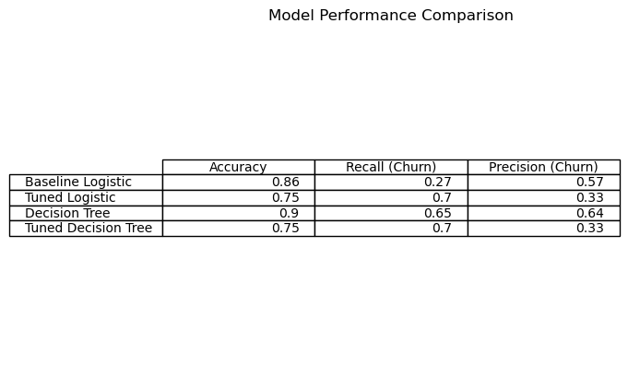

Slide 6
Model selection
From the comparison in, we see that the untuned decision tree achieved 90% accuracy on the test set with balanced performance on recall and precision.
Although this model was overfitting i.e. could have generalised and left out noise better, it is the best performing when predicting customers likely to churn.
It flagged 64% of customers that truly churned and there is a strong balance between detection and model efficiency.
The Decision Tree provides the most practical balance.

Slide 7
Drivers of churn
Customers who got in touch with customer service more frequently are more likely to churn
International plan and high daytime service users showed higher churn possibility.
Service Improvement and promotion should be targeted at the above used

Slide 8
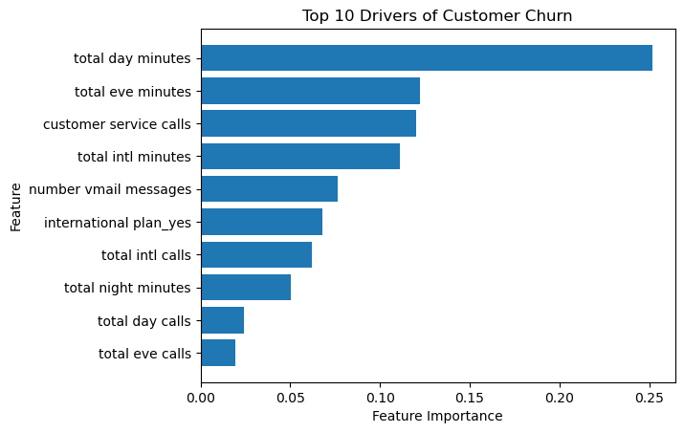

Slide 9
Conclusion and Recommendations
Monitor quality of service and duration availability of service during the daytime
Check on efficacy of the international calling plan and ways of improving it
Offer retention incentives as the service is improved.
Review customer service call details to determine major customer issues
Offer incentives for users to make calls in the evening or night
If possible, provide fresh data with more data on customers who churned historically.

